Slide 1
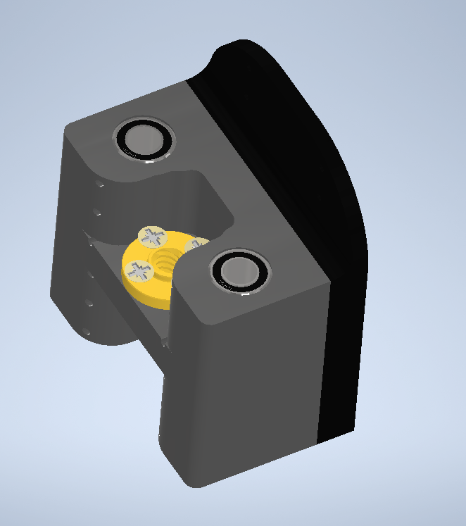
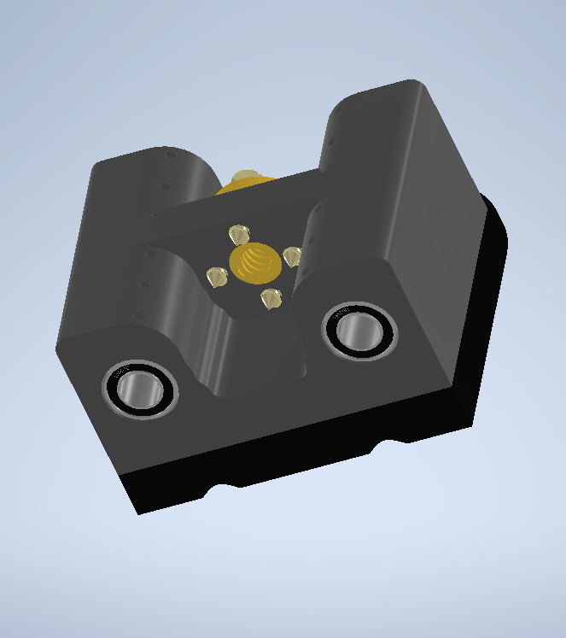

Slide 2
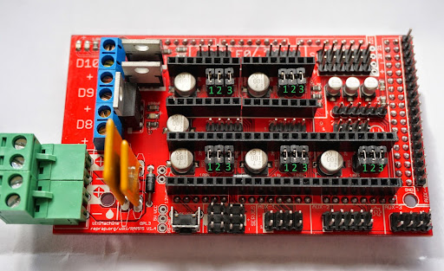

Slide 3
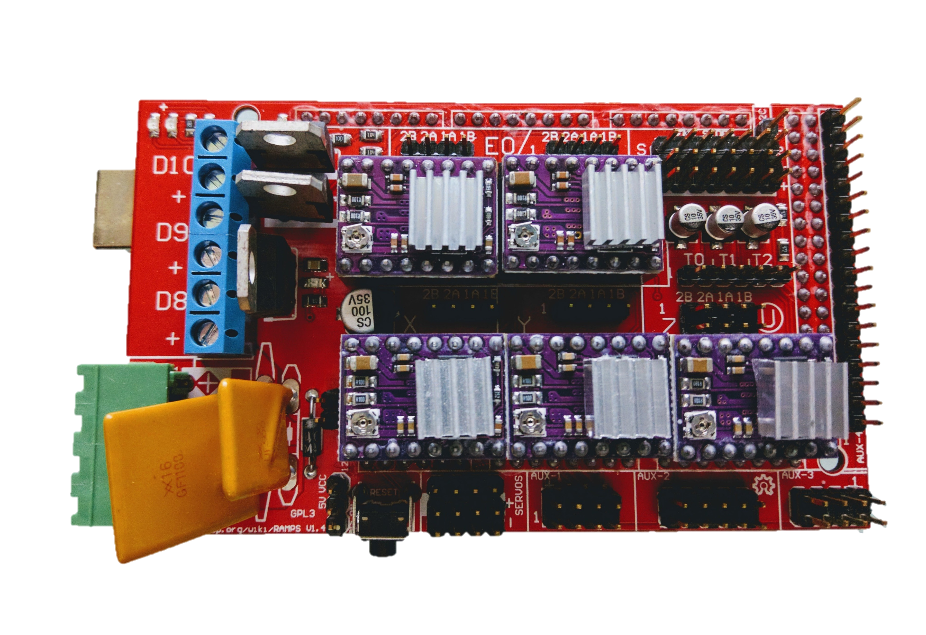

Slide 4
Motor
seringă
Motor
Z 2
Limitator
X Y Z
Termistor pat cald
Driver
pat cald
12V
ventilator
Motor
X
Motor
Y
Motor
Z 1

